Slide 1
Purpose of life
Izza-k224120

Slide 2
PURPOSE ? LIFE ?
The reason for which something is done or created or for which something exists. It is a person's sense of resolve or determination. It is to have as one's intention or objective. For some people, purpose is connected to vocation—meaningful, satisfying work.
It is a journey through living and experiencing, NOT a destination! It pertains to the significance of living or existence in general. Many other related questions include: "Why are we here?", "What is life all about?", or "What is the purpose of existence?"

Slide 3
Why do we need a purpose in life?
Guides life decisions
Influences behavior
Shapes goal
Offers a sense of direction
Creates meaning

Slide 4
Acquiring purpose in different roles of life.
CATEGORY | E.G OF EACH ROLE BEING PURPOSFULLY FULLFILED
PERSONAL | Physical and mental wellbeing, Religious obligations etc.
LEISURE | Productive skill learning, working on activities for personal growth and practicing to stay focused etc.
COMMUNITY | Helping the ones in need, sharing and caring for one another etc.
FAMILY | Spending quality time and fulfilling their rights etc.
WORK | Studying, being professional and optimistic, maintaining a healthy learning environment etc.

Slide 5
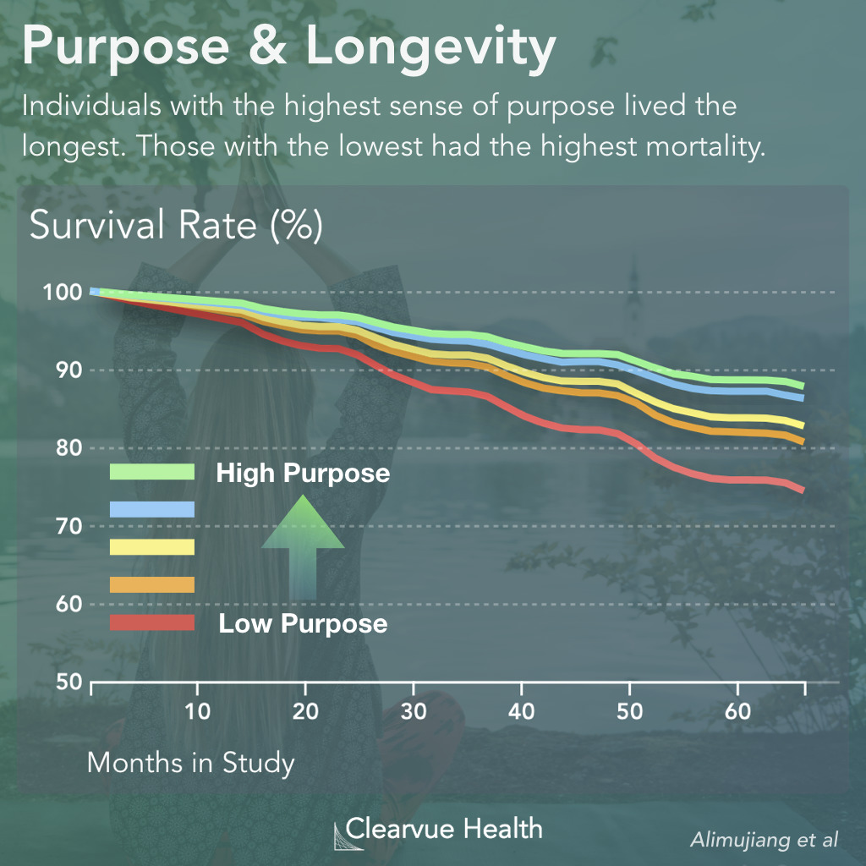
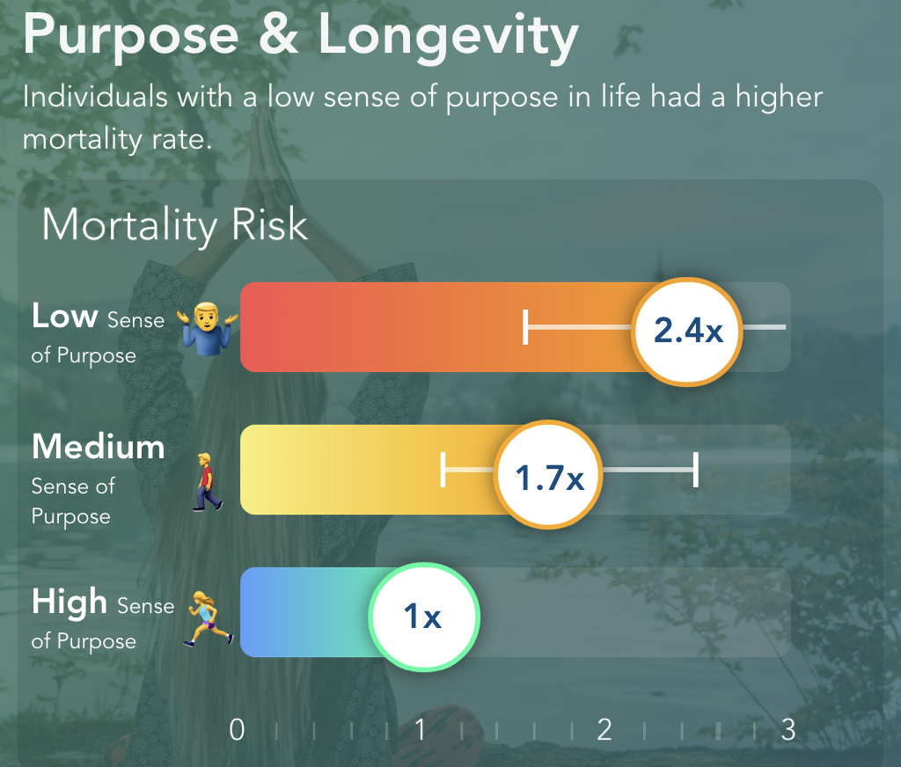
A Scientific Study On The Subject*

Slide 6
Famous Quotations on the subject *
“It is not that we have so little time but that we lose so much. ... The life we receive is not short but we make it so; we are not ill provided but use what we have wastefully.” ― Lucius Annaeus Seneca
“The mystery of human existence lies not in just staying alive, but in finding something to live for.” ― Fyodor Dostoyevsky
“The purpose of life is to live it, to taste experience to the utmost, to reach out eagerly and without fear for newer and richer experience.” ― Eleanor Roosevelt
“The purpose of life is not to be happy. It is to be useful, to be honorable, to be compassionate, to have it make some difference that you have lived and lived well.” ― Ralph Waldo Emerson
“It does not matter how long you are spending on the earth, how much money you have gathered or how much attention you have received. It is the amount of positive vibration you have radiated in life that matters,” ― Amit Ray,
“Awareness is the power that is concealed within the present moment. … The ultimate purpose of human existence, which is to say, your purpose, is to bring that power into this world.” ― Eckhart Tolle
*references[3 Charts | A Sense of Purpose Helps You Live Longer | Visualized Science (clearvuehealth.com)
Purpose Of Life Quotes (829 quotes) (goodreads.com)]

